Slide 1
JS Design Pattern Day1 Presented By :Asmaa Ahmed

Slide 2
What is Design Pattern?
Design patterns are typical solutions to common problems in software design. Each pattern is like a blueprint that you can customize to solve a particular design problem in your code.
GOF => 23 pattern in different languages : C# , Java , JavaScript

Slide 3
What does the pattern consist of?
Most patterns are described very formally so people can reproduce them in many contexts. Here are the sections that are usually present in a pattern description:
Intent of the pattern briefly describes both the problem and the solution.
Motivation further explains the problem and the solution the pattern makes possible.
Structure of classes shows each part of the pattern and how they are related.
Code example in one of the popular programming languages makes it easier to grasp the idea behind the pattern.

Slide 4
Design Pattern

Slide 5
Why should I learn patterns?
Make your life easier by not reinventing the wheel
Improve your object-oriented skills
Recognize patterns in libraries and languages
Use the power of a shared vocabulary
Patterns are proven solutions

Slide 6
Why should I learn patterns?
1. Creational: These patterns are designed for class instantiation. They can be either class-creation patterns or object-creational patterns.
2. Structural: These patterns are designed with regard to a class's structure and composition. The main goal of most of these patterns is to increase the functionality of the class(es) involved, without changing much of its composition.
3. Behavioral: These patterns are designed depending on how one class communicates with others.

Slide 7
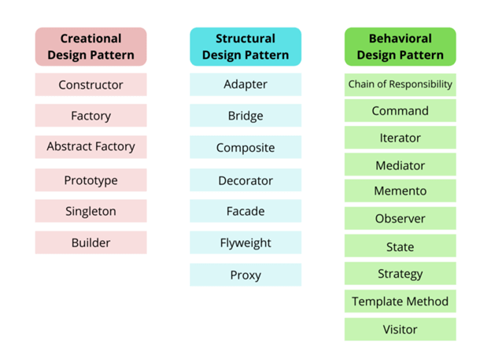
Design Patterns Types

Slide 8
Constructor Pattern
1
The constructor pattern belongs to the creational design pattern category. It allows us to initialize new objects with specific methods and properties , In classical object-oriented programming languages, a constructor is a special method

Slide 9
Singleton Pattern
2
Singleton is a design pattern that tells us that we can create only one instance of a class and that instance can be accessed globally.

Slide 10
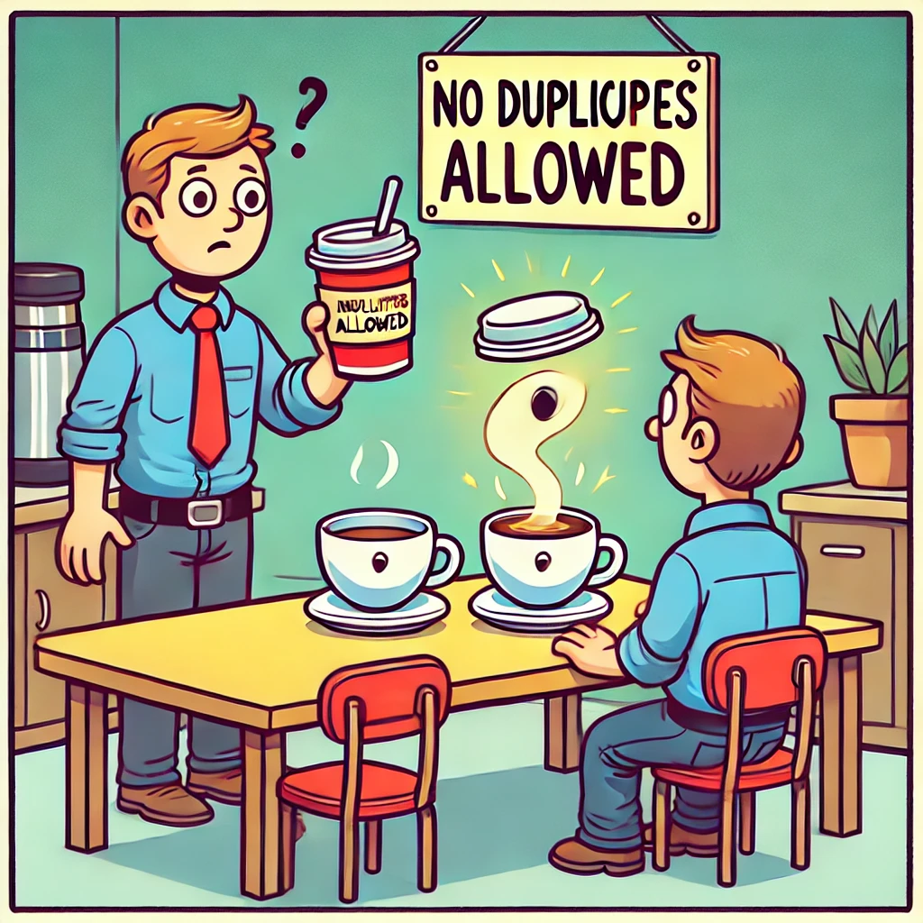
2

Slide 11
2

Slide 12
Factory Pattern
3
is a creational design pattern that provides an interface for creating objects in a superclass, but allows subclasses to alter the type of objects that will be created.

Slide 13
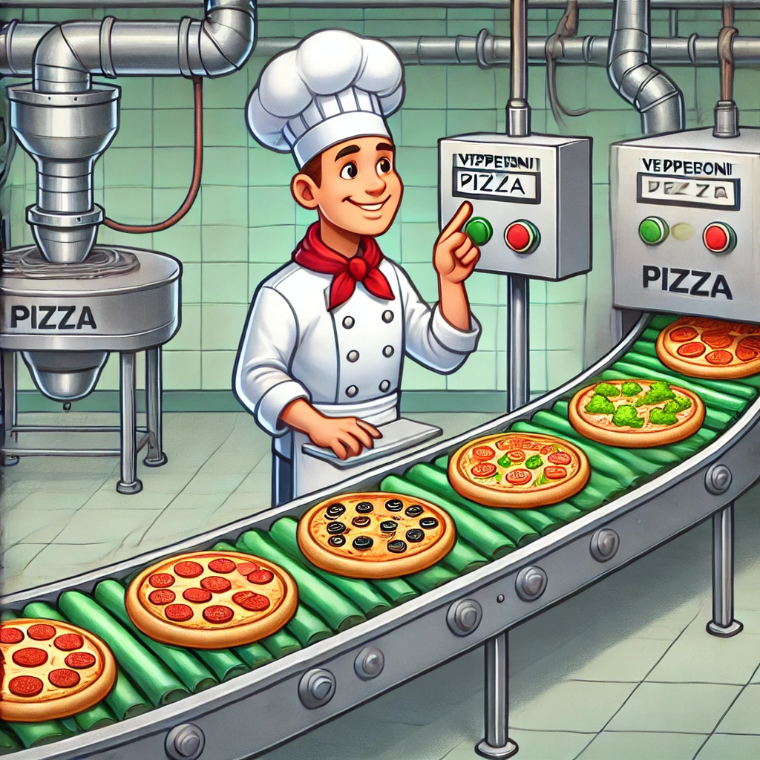
3

Slide 14
Mixin Pattern
4
Mixins are a great way to mix functions
and instances of classes after they have
been created. In other words you could use
mixins to add interesting functions to
the any class that you created earlier.

Slide 15
Builder Pattern
5
The builder pattern is a design pattern designed to provide a flexible solution to various object creation problems in object-oriented programming.

Slide 16
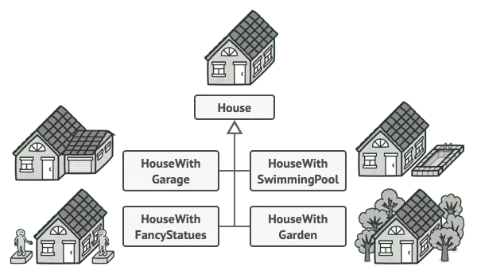
Builder Pattern
5

Slide 17
Dependency injection
6
Dependency injection is a programming technique that makes a class independent of its dependencies. It achieves that by decoupling the usage of an object from its creation. This helps you to follow SOLID’s

Slide 18

Dependency injection
6

Slide 19
Thanks!
Any questions?

